Slide 1
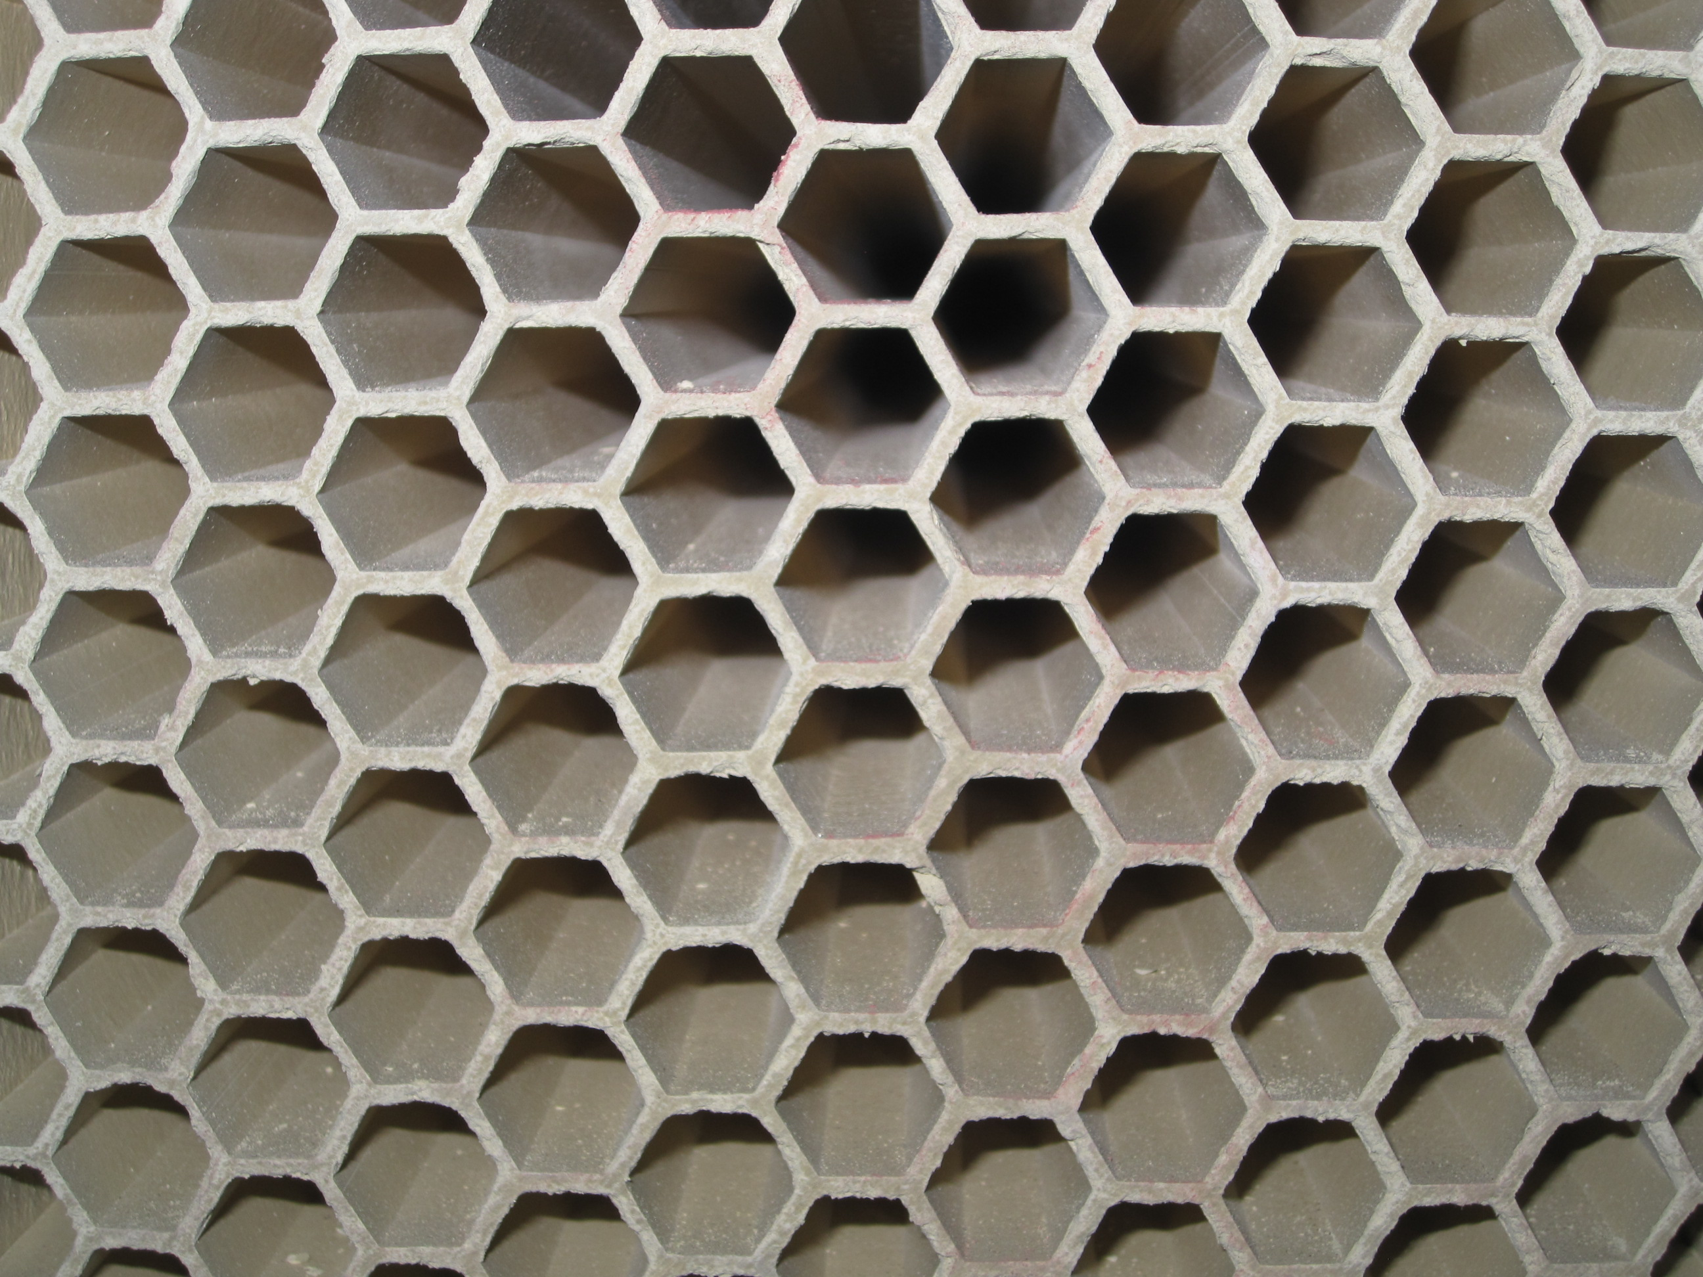
NOx Emissions Control & Reduction
Technical Development Program for Process Performance Engineers – SPREAD 2016
Mirko Weber

Slide 2
Content
Why do we care about NOx?
Environmental impacts
Holcim emissions targets
Legal limits
Where is the NOx formed?
Thermal and Fuel NOx
Influencing factors
How NOx can be reduced?
Primary measures
Secondary measures
New developments
2

Slide 3
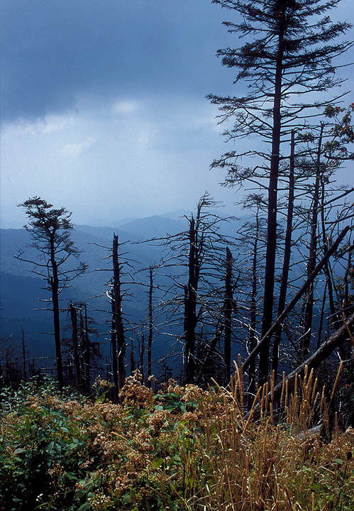
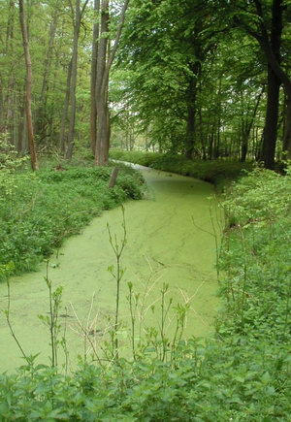
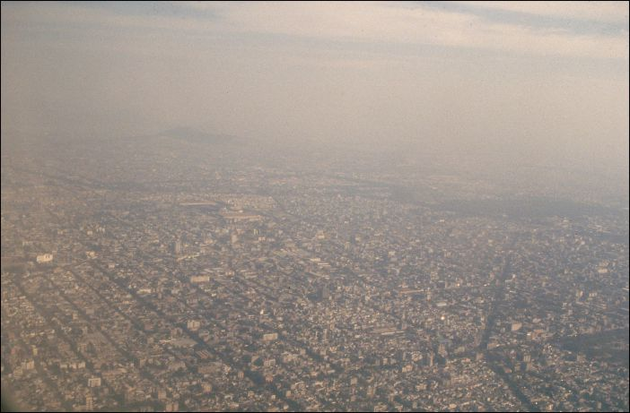
NOx is a risk for human and environment
NOx contributes to acid rain
damage to vegetation, aquatic life
NOx is affecting ozone (O₃) balance
precursor for photochemical smog contributors (ozone, “PAN”, HNO3 etc.) in troposphere → damage of the human respiratory system (lungs)
NOx can contribute to eutrophication
Influence of ecosystem by nutrient overload
3

Slide 4
Environmental regulation - A continuous evolution…
Example Holcim Italy
Source: Marco Bestetti
1800 – 2200 mg/Nm³ before 10.2007
1200 mg/Nm³ 10. 2007 – 01.2008
800 mg/Nm³ 01.2008 – 03.2012
600 mg/Nm³ since 03.2012
500 mg/Nm³ starting 2016
200 mg/Nm³ ? (Germany, Incinerators)
4

Slide 5
NOx emissions of 350 to 1200 mg/Nm³ @ 10% O₂ expected
NOx emissions plausibility check NOx in mg NO₂/Nm³, dry @ 10% O₂
Standard deviation of hourly averages is 20 - 50%
> 2000 | extreme emissions, measurement to be verified
1200 to 2000 | high emissions but possible
350 to 1200 | normal emissions range
< 350 | unlikely without any special conditions
5

Slide 6
NOx units can be misleading…
What is measured by the analyzer
ppm NO¹
400
* 2.05 mg NOx (as NO₂)/ ppm
What you read from the analyzer (depending on analyzer type)
mg/Nm³ NOx at actual O₂
820 8% actual O₂
* 11 / (21 – actual %O2)
Transformation into Standard Units
mg/Nm³ NOx at 10% O₂
695
* 2.1 Nm³/kg_{cli} at 3300 MJ/t_{cli} and 10% O₂
* 0.7 kg_{cli}/kg_{cem. material}
Transformation into ERT Units
g/t_{cem.materials} NOx
1020
¹ ~95% of the cement kiln NOx emissions are in form of NO, the rest as NO₂. Nevertheless NOx is commonly expressed as NO₂!
6

Slide 7
Conversion ppm NO to mg NO2 - Step by step calculation
Conversion: ppm x 2.05 = mg/Nm³
NO measurement (in ppm)
NOx Emissions expressed in mg/Nm³ NO₂*
Conversion: ppm x 1.34 = mg/Nm³
Conversion: mg NO x 1.53 = mg NO₂
?
Conversion:
NOx Emissions expressed in mg/Nm³ NO*
NOx Emissions expressed in mg/Nm³ dry @ y % O₂
O2 correction:
NOx Emissions expressed in mg/Nm³ dry
* Dry or wet according to measurement principle (in situ, extractive) ** water content of gas (vol %)
7

Slide 8
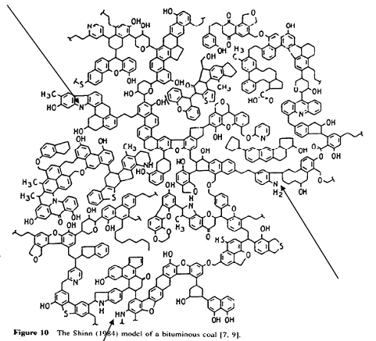
There are two main NOx formation mechanisms (simplified)
In the calciner / secondary firing from fuel nitrogen
Main flame at T>1500°C from N₂ in the air
Fuel NOx
Thermal NOx
Fuel-N
Air-N₂
HCN
N N
Intermediate products HNCO etc.
NHx radicals
NOx
8

Slide 9
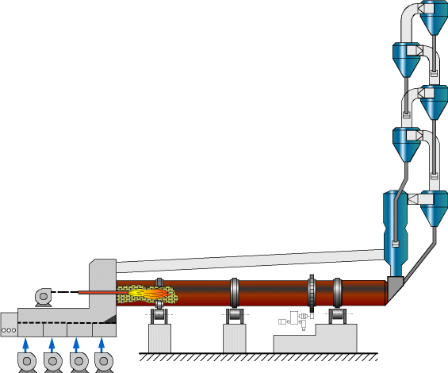
Temperature, Oxygen, Air and Fuel Nitrogen to form NOx
Small NOx quantities from raw material
N₂, O₂ in air → Thermal NOx
(T >1500°C)
Fuel bound nitrogen → Fuel NOx
(T ~900°C)
*
*Fuel NOx formation in the main firing is hampered because the O₂ is preferably used for combustion and not available for oxidization of the fuel nitrogen.
9

Slide 10
NOx from raw material proportionally low, but not treated
Becomes more important the more stringent the limit
Not treated by reduction technology (beside SCR)
Raw Mix expulsion test example → 75±30 [mg NO2 / Nm³]
10

Slide 11
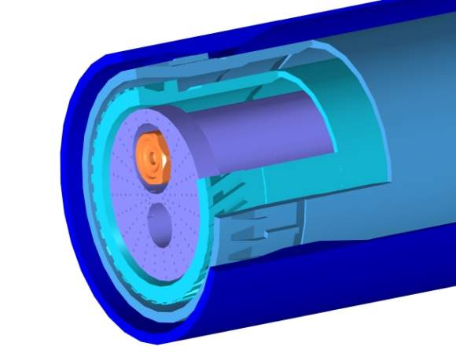
The more Oxygen the higher is the NOx formation
Main factors favoring NOx formation at main burner (1/2)
Availability of oxygen
High overall excess air rate (Kiln inlet oxygen)
High degree of turbulence (high axial and tangential momentum, retracted burner position)
Weak Internal Recirculation Zone (IRZ)
High fuel transport air (in the center of flame)
Delayed ignition and burn out of fuel (low reactivity of fuel, i.e. low percentage of volatiles, low fineness or big droplet size)
Secondary air
Axial
+
Radial/Swirl
_
Central
Radial/Swirl
Secondary air
+
Axial
11

Slide 12
The higher the Main Flame Temperature the more NOx
Main factors favoring NOx formation at main burner (2/2)
High flame temperature
High burning zone temperature (hard burning regime)
High calorific heat value
High axial / tangential momentum (strong flame)
High and frequent temperature peaks (process instabilities)
High secondary air temperatures
High residence time at high temperature (long, but strong (hot) flame / low fuel volatiles)
N₂ + O₂ → 2 NO _{d[NO]/dt = 2 K1 [N2] [O]}
12

Slide 13
Oxygen and Fuel Nitrogen raise NOx formation in calciner
Main factors favoring NOx formation in calciners
High oxygen availability (excess air rate / tertiary air, fuel arrangement)
High nitrogen content of fuel
13

Slide 14
Fuel mix characteristics and pyroprocess operation determine NOx emissions
Main influences on NOx formation
 | Thermal NOx | Fuel NOx
Temperature | +++ (T > 1500 °C) | +*
Overall Excess Air Rate (O2) | ++ | ++*
Residence Time | + | +
Nitrogen content in fuel | + | ++
Volatile matter in fuel | +* | +*
* High influence on NOx reduction mechanism
14

Slide 15
Three steps to reduce NOx – Start on top!
Reduce NOx “precursors”
Reduce NOx production by modification of existing process
Convert NOx to N₂ by adding an additional gas cleaning unit
Primary Reduction Measures
Secondary Reduction Measures
15

Slide 16
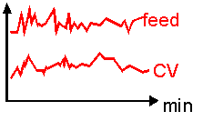
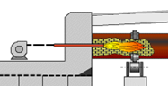
Reduce NOx formation in main burner by avoiding high temperatures and excess oxygen
Improve process stability (process optimization, expert system)
Adjust excess air (kiln inlet and calciner oxygen)
Optimize burner operation (transport air, primary air)
Improve kiln feed burnability (feed mix, fineness)
Avoid overburning (strict control of clinker free lime, target >0.8 %CaO)
16

Slide 17
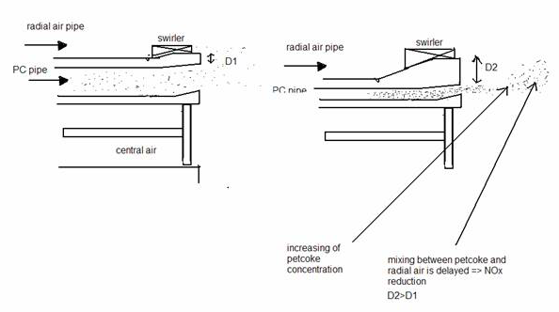
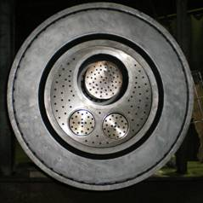
Merone: Burner modification achieves ~20% NOx reduction
Transport air diminished from 1900 to 1180 Nm³/h Coke load increased from 3.2 to 5.1 kg/Nm³
Primary air (excl. transport air) reduced from 18% to ca. 12%
New burner tip
NOx reduced from ca. 1500 to 1200 mg/Nm³, dry @ 10% O₂ (100% petcoke)
NOx reduced form ca. 900 to 700 mg/Nm³, dry @ 10% O₂ (bit-oil / petcoke mix)
D2
D1
D2
Axial air
Radial air
Petcoke
17

Slide 18
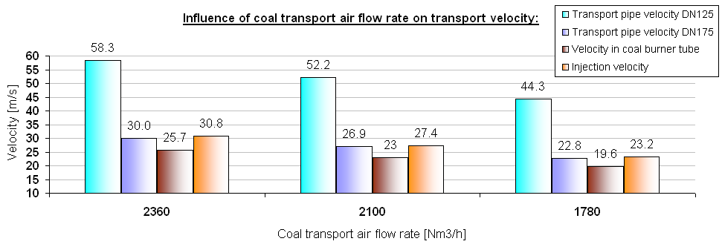
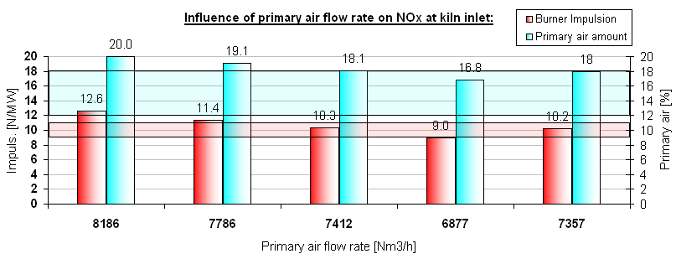
Eclépens: Burner settings optimization reduces NOx (~10%)
Burner settings: Transport air quantity optimization
Burner settings: Primary air quantity optimization
NOx = 100%
NOx = 97%
NOx = 97%
NOx = 90%
Bottleneck
Bottleneck
NOx = 124%
NOx = 100%
NOx = 89%
NOx = 89%
NOx = 80%
NOx = 89%
18

Slide 19
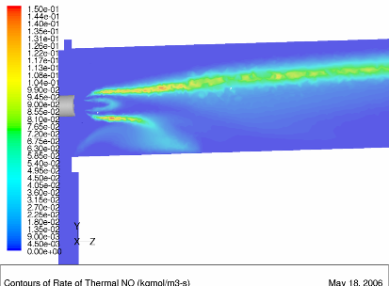
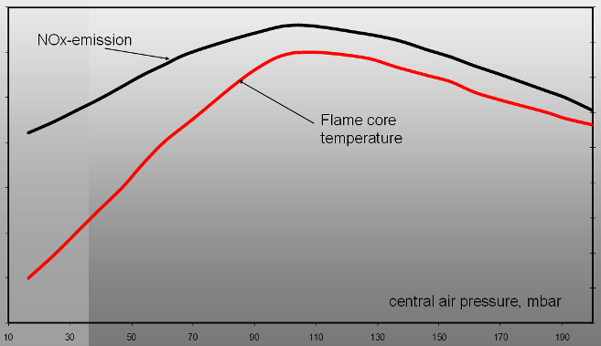
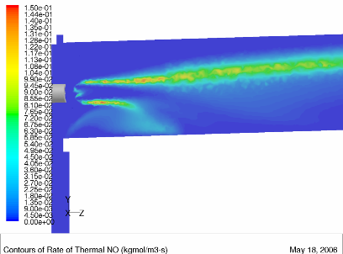
Central air reduction supports lower NOx generation
Lower central air decreases air / fuel ratio in the flame core and leads to less NOx formation
Primary Air Pressure: 150mbar
Central Air Pressure: 125 mbar
NOx (Kiln Inlet): 2700ppm
Source: Unitherm
Primary Air Pressure: 150mbar
Central Air Pressure: 25 mbar
NOx (Kiln Inlet): 1300ppm
19

Slide 20
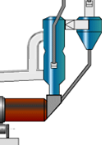
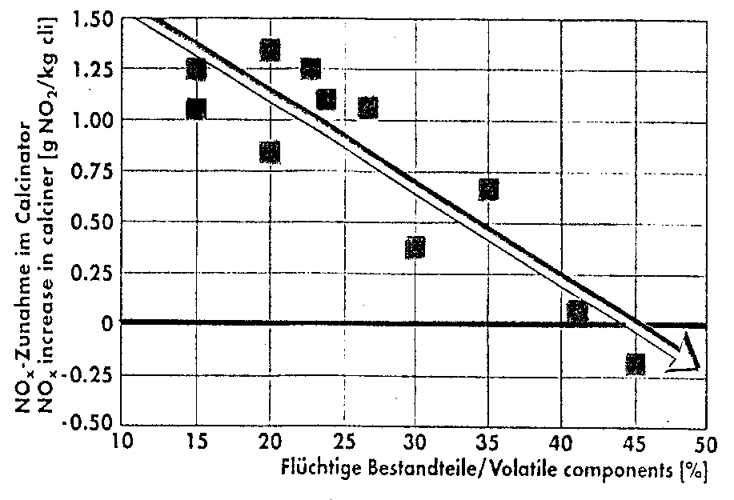
“High” temperature and low oxygen for low NOx in calciner
Destroy NOx from main burner and minimize fuel NOx formation by local reducing atmosphere and hot spot in calciner
Low NOx calciner / MSC
Fuel mix optimization
Fuel with high volatile content*
Lump fuel (small portion at kiln inlet)
+ Low nitrogen fuel
e.g. plastics, lignite
e.g. petcoke, anthracite
Source: Int. Cement Review, June 1997, p.65ff
*Reactive fuels (e.g. lignite) react so intensely at start of combustion that local reducing conditions occur (+ increased Temp.)
20

Slide 21
NOx destruction by hydrocarbon radicals in calciner
Main reaction: NO reduction with CHx radicals arisen from fuel hydrocarbons during combustion (at high temperatures)
Reduction of NO by the reaction with NHx radicals (analogous to SNCR mechanism) or other intermediate compounds such as HCN
Additional reduction of NO: heterogeneous at the fuel-coke surface
Minor role: NO reduction by CO or H2 catalyzed by meal (Fe, CaO) NO + CO → N2 + CO2 H2 + NO → N2/NH3 + H2O
21

Slide 22
Hot spot to be below thermal NOx formation temperature
High temperature (hot spot) for an increased radical pool and higher NO reduction rates …but below (dominant) thermal NOx temperature range > other restrictions regarding hot spot (refractory, build-ups) probably decisive …typical hotspot temperature in ILC ~ 1000-1200°C > flame temperatures in PCC higher (very low λ)
Low oxygen zone (local reducing condition) to prevent oxidation of intermediate compounds (the NOx re-formation), the fuel NOx formation and the hydrocarbon combustion … and for NO reduction by CO (catalyzed) > not main mechanism
22

Slide 23
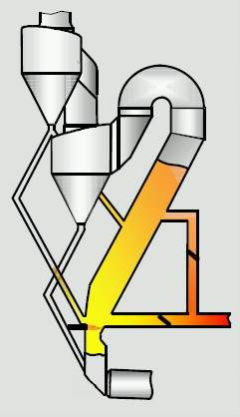
Hot spot and Reducing Conditions are the two features to operate a calciner as a “Low NOx Calciner”
Example of a Low-NOx calciner: Prepol MSC
Mealsplit:
control of hot spot
Air split or main fuel bellow tertiary air connection:
reducing conditions
“MSC”/Staged fuel: Additional “LowNOx burner” or (lumpy) AFR ! Build-ups
◆
λ >1
λ <1
❖
1000-
1200°C
⬥
λ >1
23

Slide 24
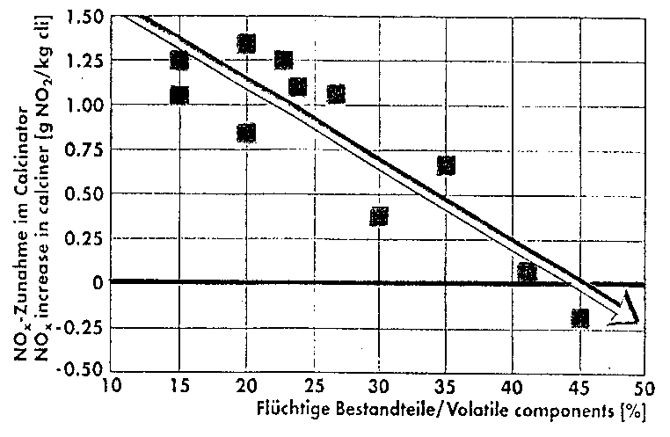
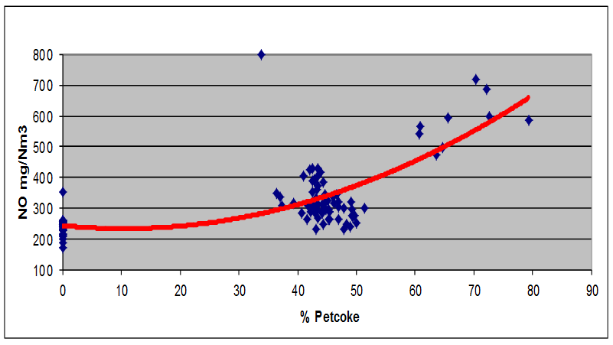
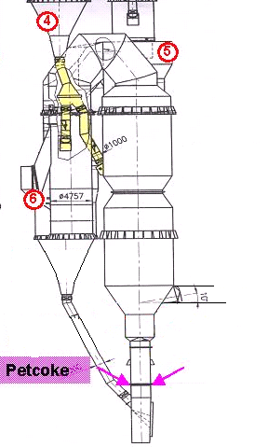
Significant NOx reduction with primary measures in calciner
Experience St.Geneviève (Holcim US)
e.g. plastics, lignite
Very good “reburn” in calciner NOx much lower with coal in PC → coke to main burner
e.g. petcoke, anthracite
Source: Int. Cement Review, June 1997, p.65ff
Experience Ramos Arizpe (Holcim Apasco)
FLS inline precalciner
Meal split used to increase calciner hot spot temperature NOx reduction from 1200 to 800 mg NO₂ /Nm³ @ 10% (ref. PPE project of Javier Niño)
24

Slide 25
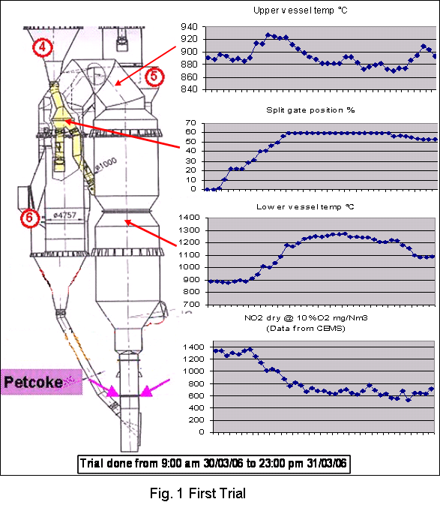
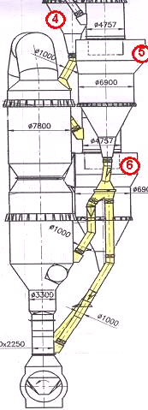
Ramos Arizpe increases calciner temperature for low NOx
25

Slide 26
The Low NOx Calciner application is limited
Revamp of existing installation to a Low-NOx design not possible (e.g. meal split not possible due to height of cyclones etc.)
Hotspot can cause refractory damages if there is no or not an evenly distributed meal curtain, inadequate refractory quality
Reducing conditions influence circulation phenomena and can cause build-ups (increased SO₂ release in reducing zone)
Difficult control of meal, fuel, air splits
CO emissions if residence time after reducing zone is too low for burnout
Increase of heat consumption (meal split)
26

Slide 27
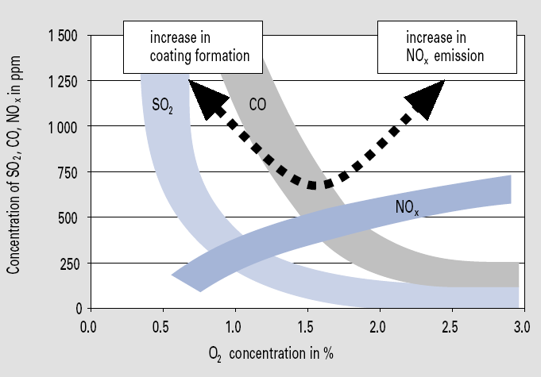
Exploit the primary reduction measures potential!
Primary measures to be applied as long as there is no negative process, quality or emission impact
Process optimizations have priority over NOx optimization
Generally not recommended: Process impacts!
Low NOx burner with too low primary air
Water and dust injection (flame cooling) „only“ to prevent NOx emission
Reducing atmosphere in the kiln
example
Source: VDZ
27

Slide 28
Potential of NOx reduction measures depends on process conditions – up to ~50% by primary measures
% NOx reduction
Not cumulative
28

Slide 29
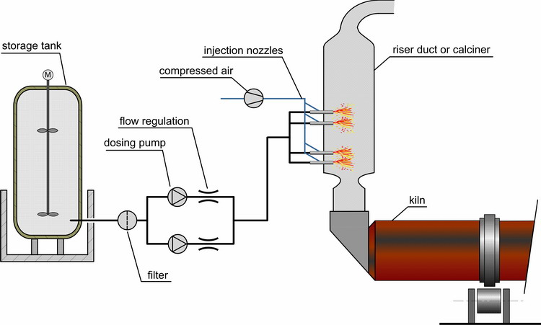
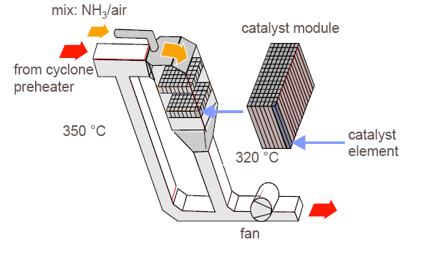
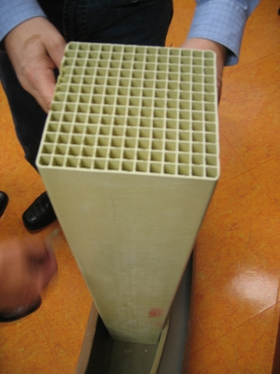
Secondary NOx reduction measures are the Selective Non-Catalytic Reduction and the Selective Catalytic Reduction
NH2° + NO → N2+ H2O
SNCR
SNCR is the proven secondary abatement technology
SCR
<10 full scale plants in the cement industry
Optimization phase ongoing
29

Slide 30
Reduction requires temperature or catalyst
Reagent: components containing NH2° (ammonia, urea, …)
SNCR
SCR
Selective Non Catalytic Reduction
Selective Catalytic Reduction
SNCR in general enough to comply with current NOx limi
If low emissions required, risk of NH₃ or CO emissions and high cost
Op. costs: 0.5 - 1.5 USD/t_{cli}
T° injec.: 850-1000°C
Red.: up to 75%
T° injec.: ~300°C
Red.: up to 95%
NH₃
SCR: Limited experience; several pilots, few full scale plants in industry
Potential for reduction of other components (e.g. VOC)
Op. costs: 1 – 2 USD/t_{cli} (?)
NH₃
30

Slide 31
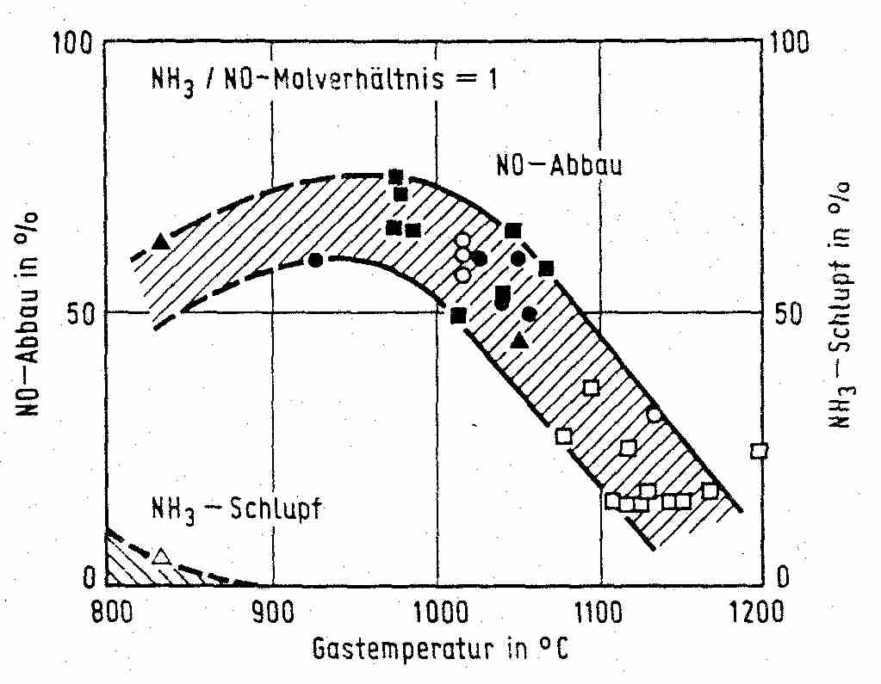
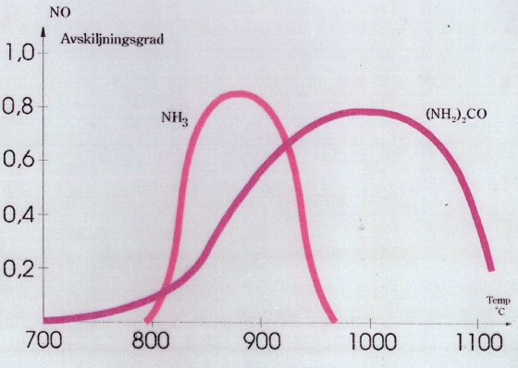
Proper temperature is key for successful SNCR
Critical for successful SNCR
Optimum temperature window: 850-1050ºC depending on reagent, gas composition etc. Too low >> NH3 slip Too high >> NOx formation
Good mixing and sufficient residence time in this window
Availability of oxygen
Ammonia allows injection at lower temperature
NH3/NOraw molar ratio = 1
O₂, CO
NO reduction
NO reduction in %
NH3 slip in %
NH3 slip
example
Gas temperature in °C
Source curves: ABC&I (generic data)
31

Slide 32
Improper SNCR performance leads to increased NH₃ and/or CO emissions …and to high costs!
Example of SNCR trial
Improper SNCR performance
CO or NH₃ emissions (ammonia slip)
High operating costs
Risk of non-compliances
Example of cost consequences SNCR optimization, i.p. change from urea to ammonia: 50% SNCR operation cost saved
32

Slide 33
The lower the NOx-target at stack, the more important is the efficiency of the SNCR
Source: Ernst Bucher, Holcim Central Europe
@ NO 900 g/t cli from the process
eta =30%
eta =45%
0.25 CHF/t cli
eta =70%
0.06 CHF/t cli
33

Slide 34
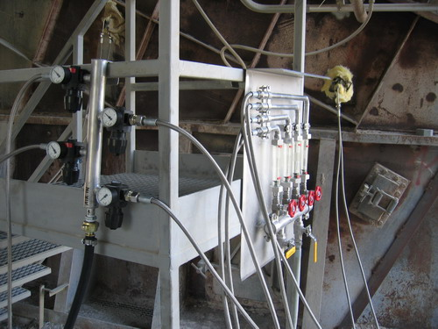

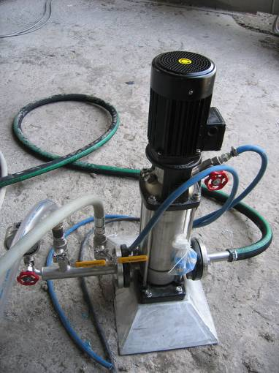
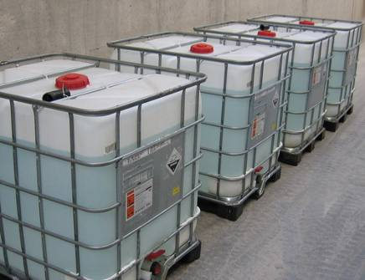
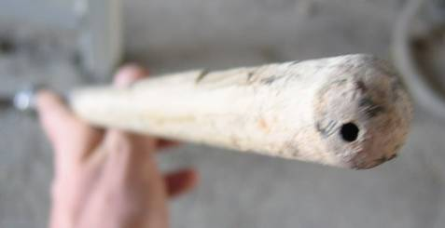
Trials for SNCR optimization and low NOx
Adequate reagent to minimize consumption and costs
Best injection location for reagent (can change due to stratification)
Adequate reagent distribution
Optimization of reagent control loop
34

Slide 35
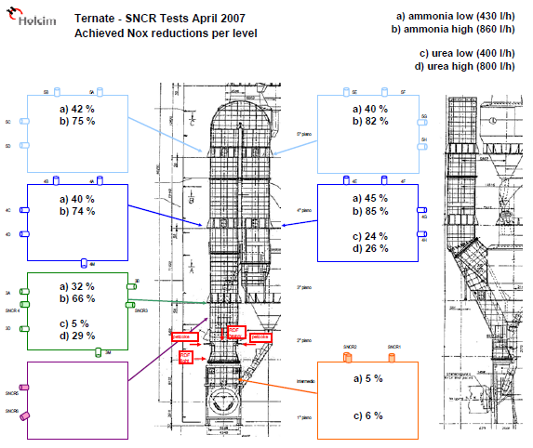
Example Ternate: Comparison of different injection levels
35

Slide 36
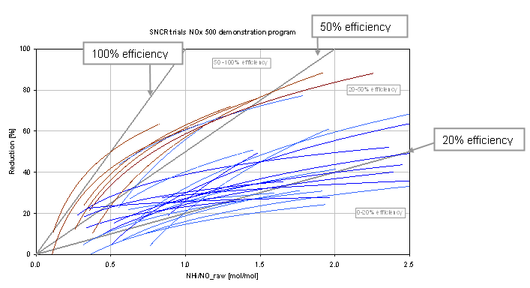
Ammonia is generally the more economic reagent
Higher efficiencies for Ammonia trials (brownish) compared to Urea (blue) (different plants)
Guide values Efficiency ~ 55% at Molar Ratio of 1-1,2 (Ammonia)
~ 30% at Molar Ratio of 1-1,2 (Urea)
Molar Ratios < 1.2 : NH₃ slip not expected
36

Slide 37
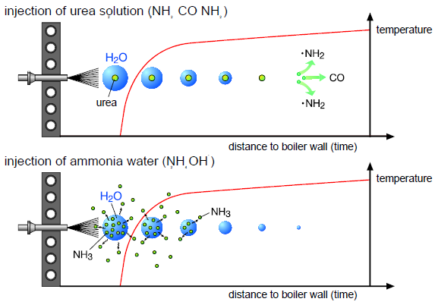
SNCR - Ammonia vs. Urea
Urea requires more residence time (water evaporation and urea decomposition)
Source: Bernd van der Heide, Minimizing NOx Emissions…, 2001
37

Slide 38
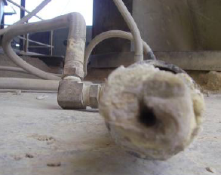
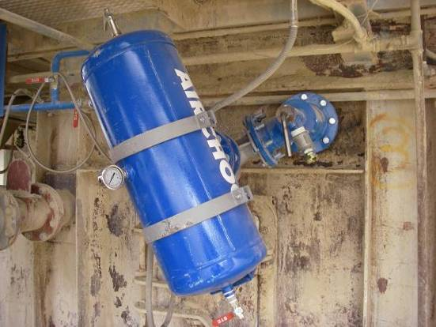
Reagent spray pattern disturbances by nozzle clogging to be prevented
Material build ups
Urea precipitation
Inadequate spray pattern
Efficiency reduction
Potential solutions
Air Blaster Nozzle
Flushing (with acidic solution)
Source: Serfain Sanchez
38

Slide 39
Optimization of SNCR control loop to reduce reagent cost
Issues: Measurement delay, CEM vs. injection location, NOx fluctuations
Control loop / PID to be optimized
Trials: Further improvement by including other parameters,
PH NOx (faster response)
Kiln inlet NOx (predictive aspect)
(BZT,…)
Example PPE project I. Gafner
Process stability reduces reagent consumption!
39

Slide 40
By exploiting primary measures and applying an optimized high efficient SNCR low NOx emissions can be achieved
NOx target 500 mg/Nm³
Can be achieved in most cases
NOx target 200 mg/Nm³
Can be achieved in some cases only (optimum conditions)
SCR to be considered in a few cases
Lower NOx limits
NH₃ limits!
Increasing reagent cost (consumption, price, availability)
Odor issues
…
40

Slide 41
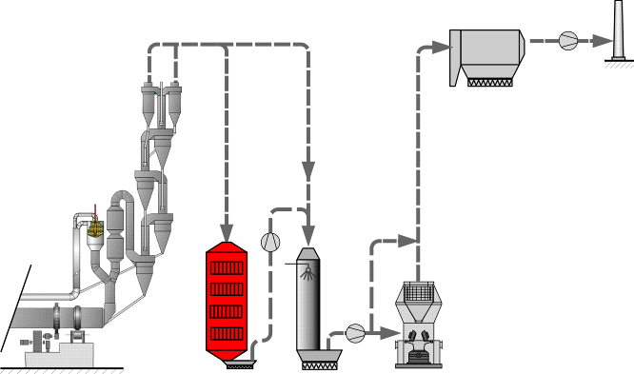
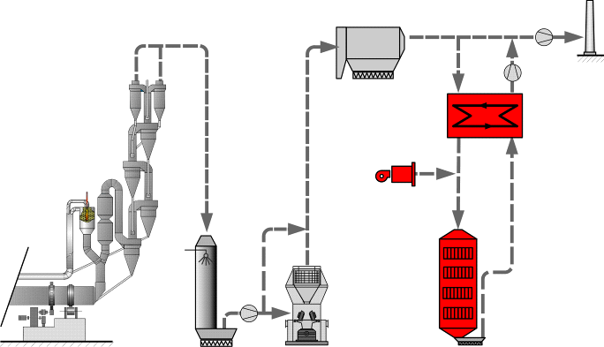
Low dust SCR installation requires reheating
Where to place the catalyst?
Advantages high dust
Proper temperature, no re-heating necessary by large heat-exchangers and in most cases (including modern systems) external heat (costs)
No additional pressure drop of heat exchangers (~10 mbar)
Advantages low dust
Lower demands for cleaning
Smaller catalyst-size (smaller pitch-size possible)
VOC released in raw mill are treated (VOCs from mill not expected in general)
41
41

Slide 42
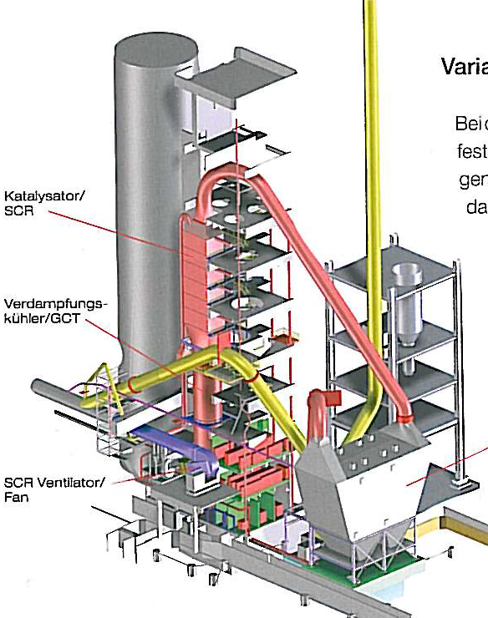
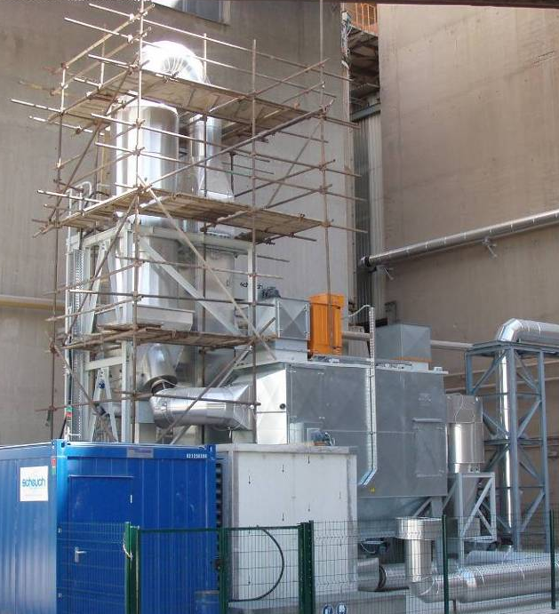
SCR experience in the industry – references (list may not be complete)
High dust SCR plants
Solnhofen 2001
Monselice 2006
Schwenk, Mergelstetten 2010
Italcementi, Rezzato 2014
Lepol SCR
Italcementi, Sarche 2007
Low-dust SCR
Rohrdorf, 2011
LafargeHolcim, Midlothian 2016
Semi-dust SCR
LafargeHolcim, Mannersdorf 2012
LafargeHolci, Joppa 2013
SCR
Mergelstetten
Monselice
RN SCR test plant
SCHEUCH Semi-Dust SCR
42
42

Slide 43
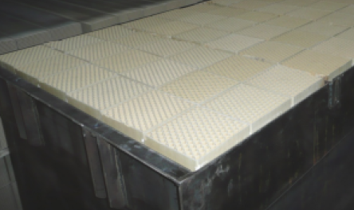
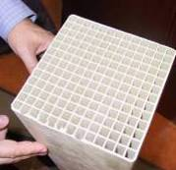
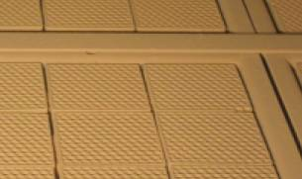
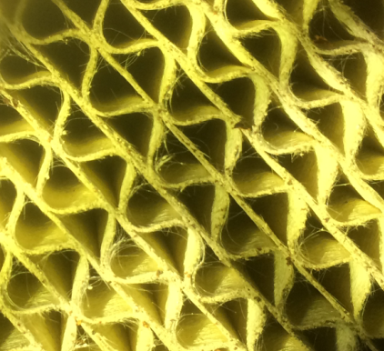
Main challenges for the SCR catalyst is not the NOx reduction, but handling of dust and prevention of poisoning
Vanadium (V₂O₅) based honeycomb catalyst (standard)
The basic requirements of an SCR catalysts are:
Suitable to handle gas with dust on the order of 100 g/m³
Prevention of poisoning, covering (Tl, Ammonia-sulfates…)
High activity and lifetime
Selectivity, limitation of unwanted reactions, i.p. oxidation of SO₂ to SO₃
Thermal / mechanical stability
Small pressure loss
Picture: TU Clausthal
43
43

Slide 44
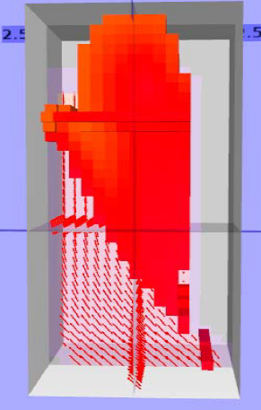
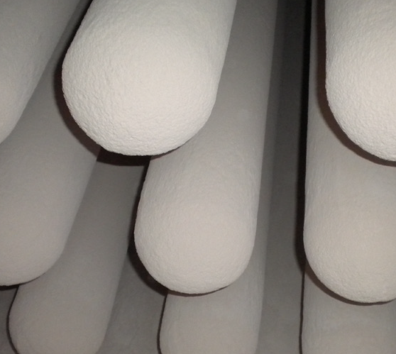
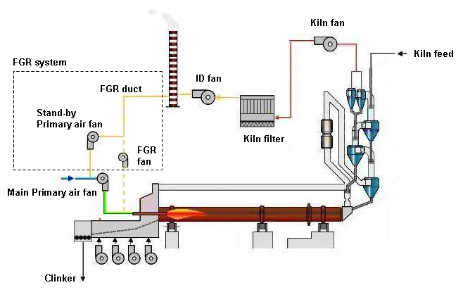

There are new approaches for NOx reduction on the way…
SNCR optimization by
Online temperature measurement
CFD
Flue Gas Circulation
Catalytic bag material
POWITEC heSNCR
FLS CataMax
GORE DeNOx filter
Source: Irwin Gafner, PPE EC
44
44

Slide 45
NOx Summary – Exploit primary and optimize secondary measures for a successful and economic NOx reduction
Primary measures
Generally low investment and operating cost for a certain NOx reduction range
Potential and efficiencies difficult to predict
Limited by process and quality impact - process optimizations have priority over NOx optimization
Secondary measures
Run SNCR if necessary (after exploiting primary measures to reduce reagent costs)
SNCR to be optimized to lower operation costs, to prevent negative consequences (CO, NH₃) and to increase the deNOx potential (ammonia in general more economic than urea)
Catalytic reduction in future as a multi-pollutant reduction technology
45
45

Slide 47
SCR costs around 10 Mio. CHF
CapEx
Engineering, Material, Erection, Commissioning and Training ~5.0 Mio. CHF
Ventilator, dust transport, injection system, gas analyzer ~1.5 Mio. CHF
Civil work, steel construction ~2.5 Mio. CHF
Electronics/Cabling ~1.0 Mio. CHF
Fees and permits ~0.3 Mio. CHF
Total ~10 Mio. CHF
Operation costs
Depending on conditions ~1 CHF/tcli assuming no exhaust re-heating and 4 years catalyst lifetime
47
47

